Slide 1
ITIS 6162 - KDD
Final Project
Bhargavi Arcot Ramesh - 801079105
Likhith Kumar Reddy Suram - 801085629
Manisha Sathanur - 801069595
Venkata Sai Santosh Perumalla - 801029180

Slide 2
OverView
About project
Data Preprocessing
Feature sets used
Models built
Evaluation of results
Challenges faced and future direction

Slide 3
About Project
Here we have hand-selected 500 articles for the HITs from five health topics. Based on the given corpus we need to find :
The average surprise rating from the three raters for each article using your proposed feature set.
Each individual raters surprise for an article based on your proposed features.

Slide 4
Data Preprocessing
Here we are performing Data Preprocessing on the data we have as follows:
500MNTNews - Removing stopwords, spaces, special characters.
‘ground_truth_one_row_per_article.csv’ - We need to fill in the missing data if there is any.
Ex:- We need to fill in the ‘NaN’ data with the mean.

Slide 5
Feature Sets
Based on the given features we need to add new features by mining the data ( 500MNTNews ) by passing our own features which plays a key role in raters surprise.
For Example we can take a bag of surprise words, wh words, any adjective words, and based on your own intuition by checking out articles.

Slide 6
Models Built
To predict the average surprise rating & individual human raters surprise rating we use:
Support Vector Machine
Naive Bayes Classification
Logistic Regression
KNN Model

Slide 7
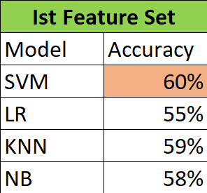
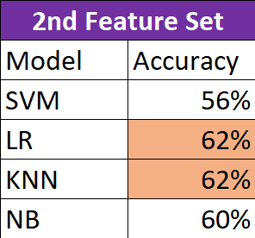
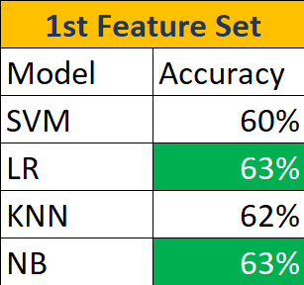
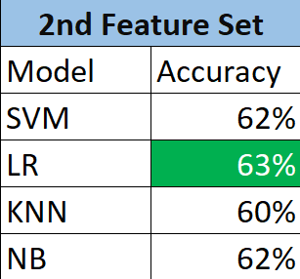
Evaluation of results
Based on the models we built the accuracy results as below
Avg. Surprise Rating
Individual Surprise Rating

Slide 8
Challenges Faced & Future Scope
From very low Accuracy to a Moderate Accuracy
Feature Set Selection
Intuitive Data Selection
Inconsistent Accuracy.

Slide 9
Thank You 😊

